Slide 1
OFFLINE BOOK STORE
Presented By
Yamini Keerthi Vadlapatla
Batch : 2021 – 6708
Under the Guidance of,
Pooja Mehta

Slide 2
INTRODUCTION
Bookstore is the place where the people will be able to get books of their choice at reasonable price. There can be textbooks, story books and many other books Available at the book store. But if it is the giant book store then the management of it will be very difficult. So the books management system application will help in maintaining all these details at one stretch. The bookstore management system will hep in maintaining the details of the books available, author names, book numbers, title names, price.

Slide 3
LANGUAGE & PLATFORM
Language : Core Java
IDE : Eclipse
Operating System : Windows

Slide 4
FUNCTIONALITIES
Display All
Search by Author
Search by Title
Search by BookNo
Exit

Slide 5
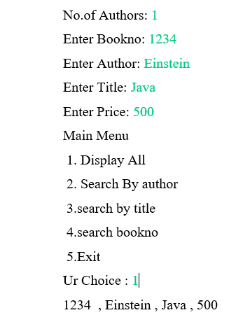
Project Screenshots
Display All

Slide 6
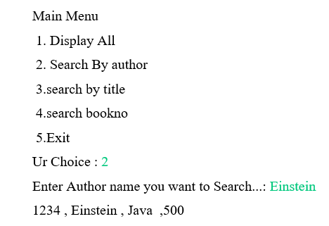
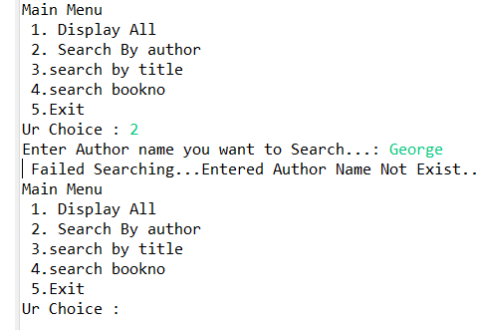
Search by Author

Slide 7
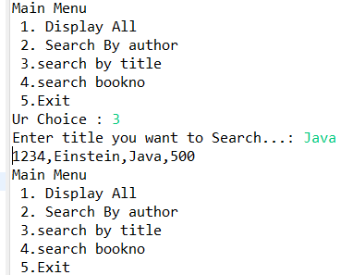
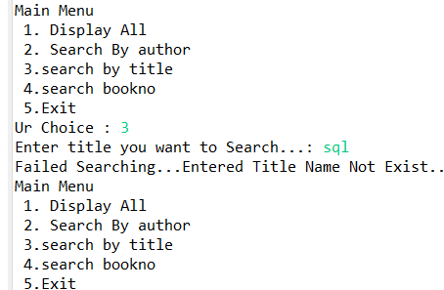
Search by Title

Slide 8
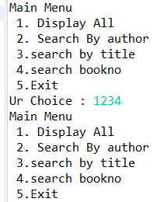
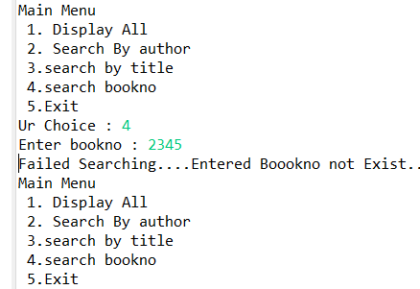
Search by Book No

Slide 9
Thank You

